Slide 1
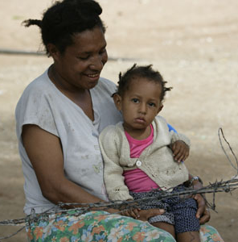
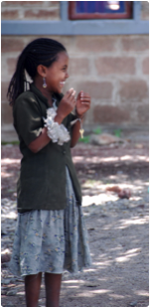
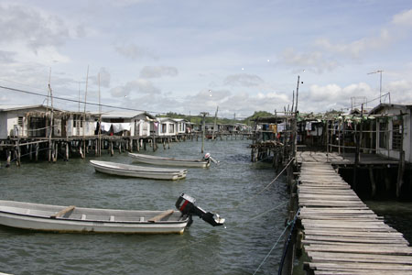
Is small really beautiful?
Graham Teskey
Ministry of Foreign Affairs ad Trade
Wellington
August 7th, 2019

Slide 2
Contents 6 slides
Preliminary reflections
Take Tuvalu….
Advantages of smallness
Disadvantages
The public service
Concluding

Slide 3
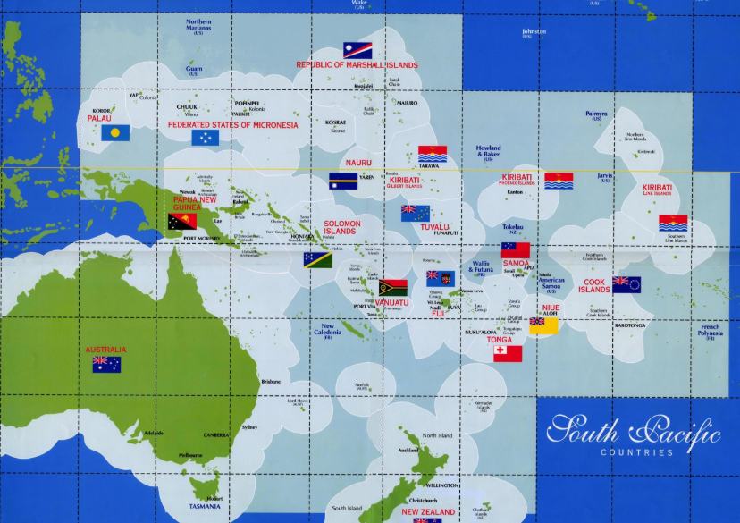
Lots of blue…

Slide 4
Preliminary reflections
Little interest in VSIDS
No common definitions: 1957 - The International Economics Association suggested small states to be those less than 10 million people…1969 UN said less than 1 million, Commonwealth and WB say 1.5 million….which gives 49 countries (36 island states, and 13 non-island countries: Botswana, Djibouti, Equatorial Guinea, Estonia, Gabon, the Gambia, Guinea-Bissau, Guyana, Lesotho, Montenegro, Namibia, Qatar and Swaziland)
Why not size or contribution to global GDP or size of EEZ?
Well population won out: UN says 10 m the cut off – meaning 105 out of 193 UN members are ‘small’
What about micro-states? UN says 1 million…
The number of islands will affect politics, economy, society and public administration: single islands (Nauru; Dominica; St. Lucia); pairs of islands (Antigua and Barbuda; St. Kitts and Nevis); consolidated groups of islands (Grenada; St. Vincent and the Grenadines); archipelagos of many islands (Kiribati’s 3.5 million square kilometres contain 33 atolls. Most pacific states fall into this category)

Slide 5
The challenge: Tuvalu
The world’s fourth smallest state by population
Just how difficult can it be to govern 9,000 people – about the size of Greymouth on the west coast of South Island….
Big ambition. Its Constitution declares that: “the guiding principles of Tuvalu are agreement, courtesy and the search for consensus, in accordance with traditional Tuvaluan procedures, rather than alien ideas of confrontation and divisiveness”.
Does the country’s size enable or constrain such a lofty aim?
When Tuvalu gained independence in 1978, its civil service employed 387 officials
Is this a viable state? How to deliver functions such as foreign office or defence?
Challenges: economies of scale; remoteness, vulnerability, HR, natural resource shortages…
But….in terms of governance- about what one would expect given the level of GNI per capita

Slide 6
Advantages of smallness
Cohesive political economy with high levels of social capital
Everyone is related so trust is high
Public service closer to the population so more responsive and aware of needs and aspirations
Leadership roles may be more respected than in larger societies (?)

Slide 7
Disadvantages
From the simple to the profound….:
Cannot possibly cover all sovereign needs
Cannot overtrain cadres
Those with skills and competencies often overstretched
Reciprocal obligations threatens decision making in the public interest
Patronage politics
What Max Everest-Phillips has called bureaupathology: “anxiety due to alienation, limited promotion prospects, less-than-adequate pay and conditions, pessimism, sense of powerlessness, and the apathy of “muted frustration” over the erosion of independence and professionalism with the blurring of roles between politics and bureaucracy”
short-term interests dominate due to impact on close knit (and physically close_ communities
The impossibility of impersonal service delivery: again reciprocal obligations and expectations dominate

Slide 8
The Public Service
Hypothesis:
The rational-legal-impersonal model of professional public service may not be applicable in VSIDS, and smallness actually makes things harder not easier
But if we discard this notion, what can we offer small island countries? Do we know enough to give any advice on PSM / PSR?
Are we limited to what the management geeks call ‘business process re-engineering’, or tinkering around with organisational structures, rather than incentives, motivations and the ‘rules of the game’” (or at least the rules of what we think the game is….)?

Slide 9
But……..concluding
Size is not destiny
Vulnerability is not the same as a lack of capacity
Importing public service reform models from outside may be even less appropriate than in larger countries, as the prevailing system may be easier to overwhelm

