Slide 1
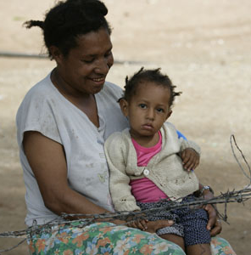
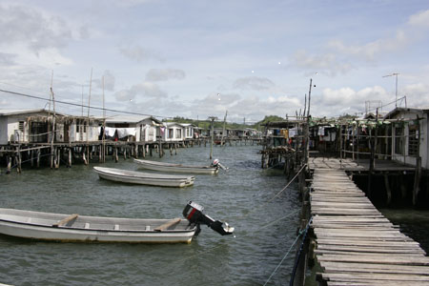
Political economy analysis – or a political approach to programming: how and why?
Graham Teskey
Ministry of Foreign Affairs ad Trade
Wellington
August 8th, 2019

Slide 2
Contents: 12 slides
Quoting DFID
Why do it?
‘Levels’ of PEA
Basic framing
A problem driven approach
Plotting
Closing words

Slide 3
Quoting DFID….
“…[it] is the attempt to find out what is really going on in a situation, what lies behind the surface of the immediate problem, challenge or request. Usually this is formulated with jargon around power, rules of the game, formal and informal systems etc….”
Alan Whaites – DFID Senior Governance Adviser, 2017

Slide 4
Why do it?
To understand why things are as they are and not like something else work
We use political approaches to programming to:
Why change is / isn’t happening
Where positive change is emerging and why
Understand what those with power want and don’t want
Improve our programs: what, how, who, where, why
Achieve better outcomes (technically sound, politically possible)

Slide 5
‘Levels’ of PEA
Issue specific analysis: for illuminating a specific policy or programmatic issue
Sector level analysis: for identification of specific barriers and opportunities
Country analysis: for general sensitisation to country context
Global/regional analysis: for international markets, political institutions and commitments, and transboundary networks

Slide 6
Basic framing
‘The key question addressed by DoC is how policy and institutional reforms that benefit poor people emerge and endure, or why in many cases they are blocked. The aim is to identify what factors (the drivers of change) will create incentives for change over the short, medium and long-term’. (DFID, 2009)
Structures, defined as the long-term contextual factors. Generally, these are not readily influenced, either because of the time scale needed, or because they are determined outside the country
Institutions, which can be formal in the sense of constitutional rules and codified laws, or informal in the sense of political, social and cultural norms
Agents, including internal actors and external actors

Slide 7
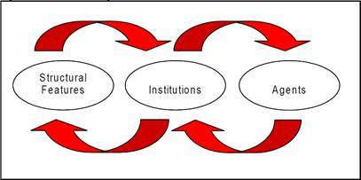
Diagrammatically

Slide 8
Or as the Dutch do it - SCAGA
Foundational Factors – factors that fundamentally shape the state and political system and territorial integrity, geography, religion and geostrategic position
The Rules of the Game – formal and informal institutions that shape the quality of governance, topics related to state – society relationships and the distribution of power
Here and Now – current context of the main actors/stakeholders and its impact on governance structures and corruption practices
Implications for Change – implications of the analysis and options/ entry points for programming

Slide 9
A problem driven approach
Problems can be defined at international, country, sector, sub-sector, policy, project or thematic level
Problems should be clearly defined and operationally relevant
Problems do not necessarily have to indicate areas of difficulty - a similar approach can be taken to understanding ‘islands of effectiveness’
Problems should have a governance or political economy dimension, though the approach does not identify governance as the main or sole bottleneck to development

Slide 10
Get the problem right
Policy-based problems
MFAT is considering supporting the establishment of a national health insurance system in country X. How much political will exists in support of the scheme and where might political resistance be expected?
A water and sanitation project is experiencing problems with lack of maintenance and breakdown of infrastructure. Why are local institutions for operation and maintenance not working properly?
Country or governance problems
Ethnically based patronage systems are undermining elite incentives to deliver development. How can MFAT approach this problem in designing its programmes?
Public Financial Management in country X is undermined by weak budget execution. Why are formal institutions of budget control (e.g. Parliament, Accountant General) unable to ensure oversight, and who in practice influences how the budget is released?
Sector problem
Previous liberalisation reforms in the agricultural sector have not been successful in country X. Why is this the case and what measures would be more successful under a new sector programme?

Slide 11
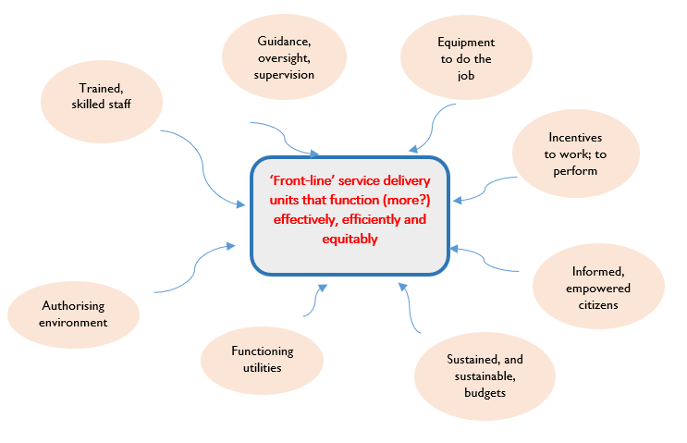
But – take care on defining the problem
Political as well as technical drivers of health sector problems and challenges
Understanding how key national/local counterparts define the ‘problem’ (not the donor or external actors)

Slide 12
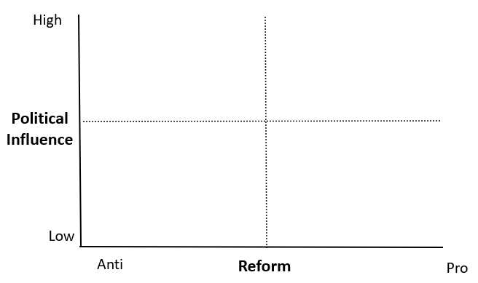
Plot the main actors – organisations and individuals

Slide 13
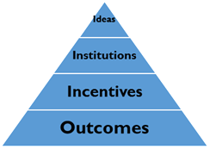
Closing words
Involves judgements
Can be controversial
How transparent can should a donor be?
Only an aid to decision-making, like CBA
Should not be a one-off up-front exercise – needs to be linked to TWP and represent a way of thinking
Remember the six Is – incentives, interests, institutions, ideas, individuals, and influence

