Slide 1
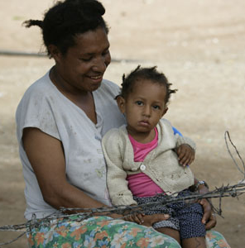

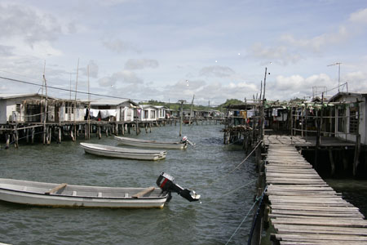
Is governance indispensable in development?
Graham Teskey
Ministry of Foreign Affairs and Trade
Wellington
August 7^{th,} 2019

Slide 2
Outline – 9 slides
The election of Barak Obama – remember him?
The emergence of ‘governance’ in development
Some definitions
Governance: differing views
Becoming a cynic
The answer!

Slide 3
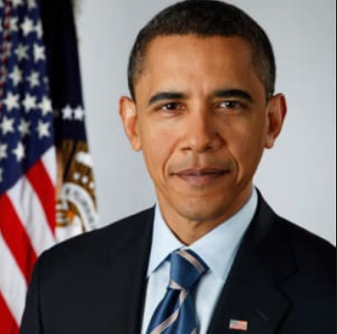

POTUS 2008

Slide 4
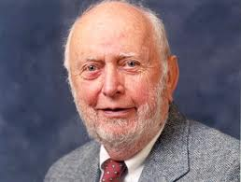
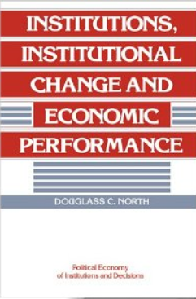
The 1990s
Two drivers
Intellectual: Douglass North for his work on institutions and ‘the rules of the game’; an antidote to the reification of neo-classical economics
Practical: The failure of ‘first best economics’, structural adjustment, the Washington Consensus, the state as ‘impartial’ arbiter………..the mismatch between what was happening on the ground and what the conventional wisdom was telling us

Slide 5
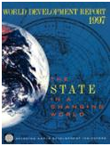
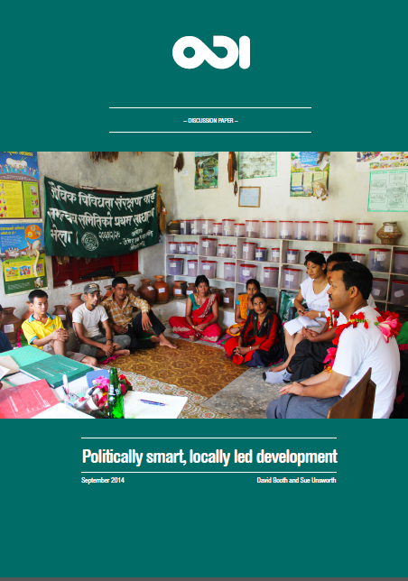
The emergence of governance and institutions
Phase 1
Phase 2
Putting the thinking into practice: PEA early 2000s
Phase 3
Learning to think politically: getting to grips with institutions; the ‘rules of the game’ 1990s
Politically smart, locally led development: “Doing Development Differently” now
WDR 1997 The State in a Changing World
DFID Drivers of Change
Thinking and Working Politically (TWP)

Slide 6


Some definitions
Governance is the exercise of political, economic and administrative authority necessary to manage a nation’s affairs
The exercise of economic, political, and administrative authority to manage a country’s affairs at all levels. It comprises mechanisms, processes, and institutions through which citizens and groups articulate their interests, exercise their legal rights, meet their obligations, and mediate their differences

Slide 7
Differing contemporary emphases
  Governance as just another sector: PFM, anti-corruption, law and justice etc
  Governance as liberal democracy: promoting a particular form of government (through elections, parliaments/assemblies, political parties etc)
  Governance as improving aid effectiveness: building the capacity and effectiveness of the state:
  the institutions and organisations that make up the state
  state-building itself
  Governance as a way of thinking about development: about power: how it is used, in whose interests and how it is reproduced. It is about the rules of the political / economic game

Slide 8
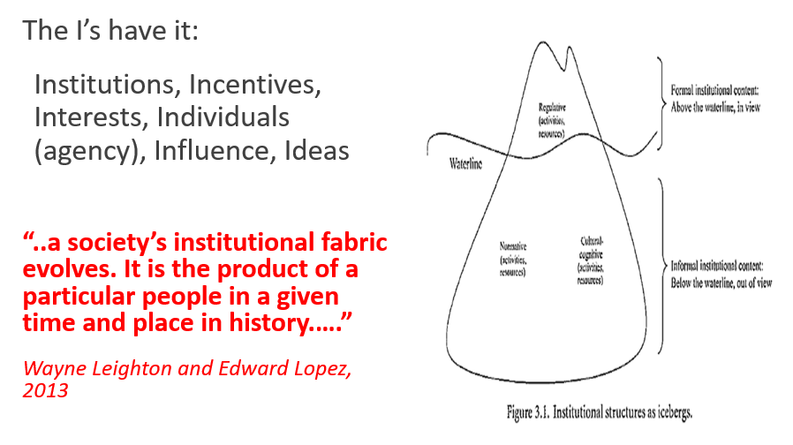
Governance as a way of thinking

Slide 9

Governance requires you to become a cynic
“But at its best, cynicism is a greater force for progress than optimism. The optimist underestimates how difficult it is to achieve real change, believing that anything is possible and it's possible now. Only by confronting head-on the reality that all progress is going to be obstructed by vested interests and corrupted by human venality can we create realistic programmes that actually have a chance of success. Progress is more of a challenge for the cynic but also more important and urgent, since for the optimist things aren't that bad and are bound to get better anyway”
Julian Baggini, ‘In Praise of Cynicism’, 11 July 2013

Slide 10
So – is governance indispensable?
  It all depends on what you understand by governance.
  If you consider governance to be just another sector, then ‘governance sectors’ may help you achieve your own aims (better financial management, less corruption)
  If you consider governance to be liberal democracy then the evidence is clear – it is absolutely not indispensable. The evidence shows that countries get rich then they get democratic, not the other way around. Here governance (ie liberal democracy) may be intrinsically worthwhile of itself, but it is not instrumental in poverty reduction and economic growth
  If you consider governance to be state-building, then it is all about governance. And nothing else. Francis Fukuyama has written two volumes over almost 1,000 pages explaining how different combinations (and sequences) of democratic accountability, the rule of law, and state capacity have led to modern, rich, high-performing liberal democracies. (And his conclusion for aspiring MICs? There is no pre-defined route. Each country has to plot its own path. Great eh, after 1,000 pages….)
  If you consider governance to be a way of thinking about development (the rules of the game, power, authority) then it is indeed indispensable. All change generates winners and losers…and often the losers will fight back, as the 44th President found out…..

