Slide 1

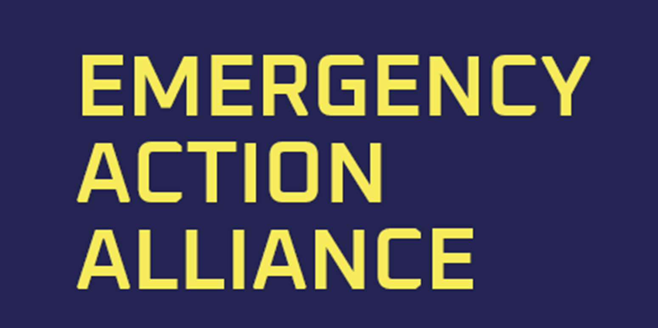
introducing me
Chris Cattaway
humanitarian consultant
and other miscellaneous adventures ..
based in Dunedin
chris@galdac.com
+64 21 031 2169

Slide 2

EAA (formerly JAM)

Slide 3
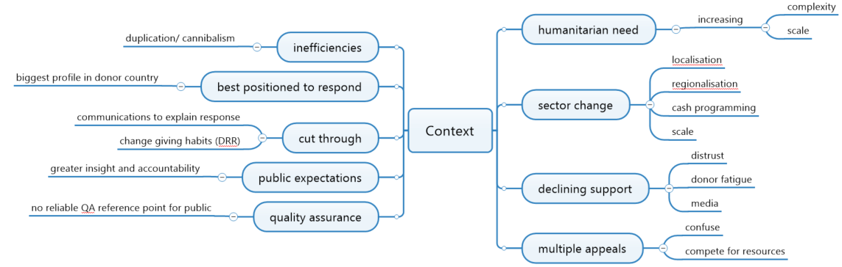

Slide 4







background context
1973 – 1993 Successful Mechanism hosted by ACFID
2-3 unsuccessful attempts to rekindle collaborative fundraising for disaster responses
2H2018
1Q2021

Slide 5



members
No new members for 3 years
3 tiers of membership subscription - members have paid or committed AUD 1.5m (non refundable)
As an intervention to mitigate Covid DFAT contributed AUD200k in April 2020

Slide 6
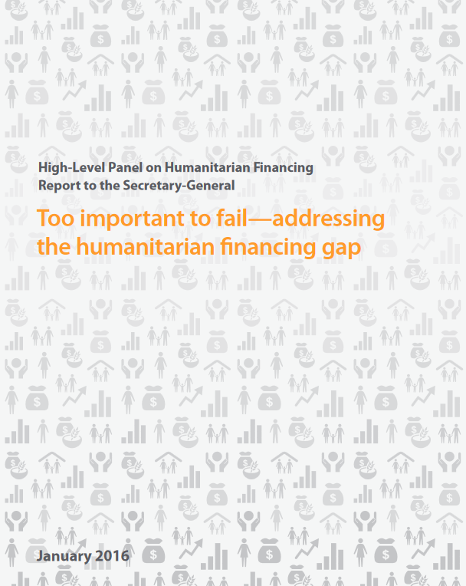
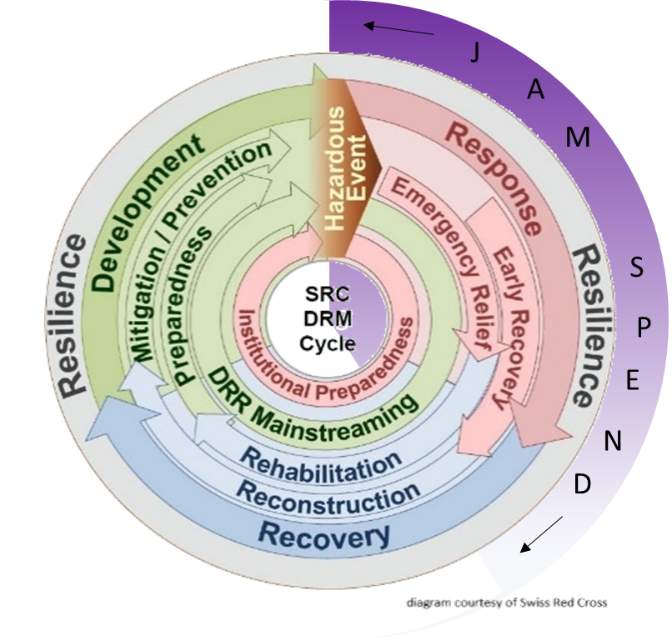
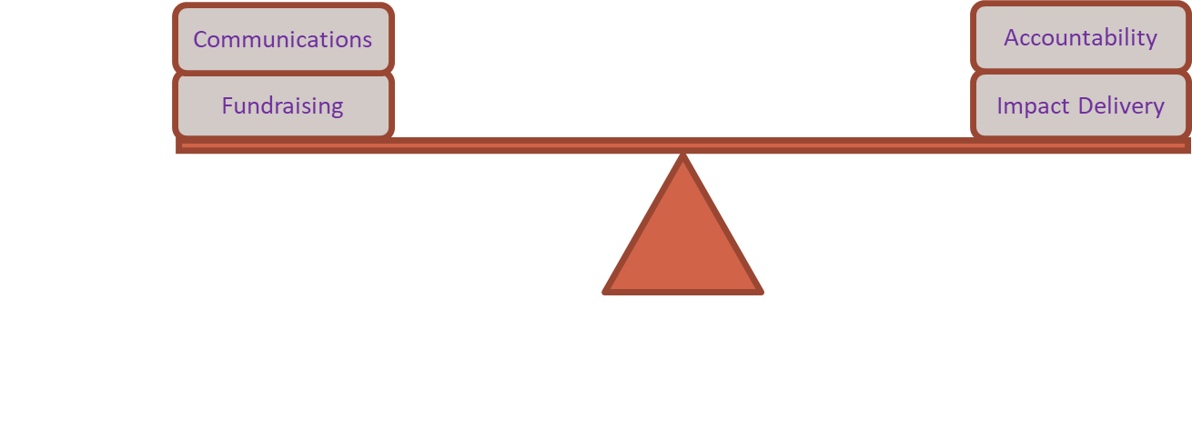
move to prioritising impact
Focus on Impact (not only $$)
Performance-based Allocation of funds
Value of unrestricted funds
Value diversity of approaches
Grand Bargain
Shape public mindset towards DRR funding
Performance Based Allocation
Peer review

Slide 7



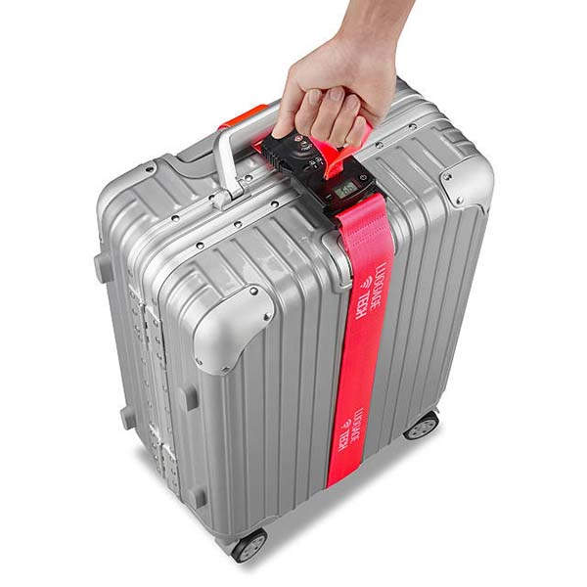
Communication and Broadcast partners
Members will handle social media because they co-brand with EAA
Field media team on 6 hours standby
After that pre-agreed templates for members to provide content
1 NGO voice to shape a more sophisticated understanding of disaster risk management
Grow overall donations by collaboration rather than cannibalising each other’s funds through competition
Quality of communications is one of the 4 performance assessment indicators

Slide 8
Allocation formula
Allocation %age
public profile / market position
(proxy RDE)
Humanitarian Capacity (proxy humanitarian spend)
(HS)
Previous Performance
(as assessed by peers and valuing different colours of good)
Disaster Risk Reduction spend
(DRR)
Allocation Baseline Indicator = (0.5 x RDE) + (3 x HS) + ( 3 x DRR)
ABI modified (+ /- ) based on past performance
EAA members may opt-in to each response. Allocations depend on how many have opted in.

Slide 9

performance Assessment
Values “different colours of good” – agencies have different approaches and specialisms and operate in different stages of the disaster response cycle
Performance assessed by peer-review
Impact (measured against impact benchmarks)
Value for money
Consistency with capacity identified when the member opted-in to the appeal
Quality of communications
has maximum impact been leveraged from unrestricted funds?
“Best Placed to Respond” are encouraged to respond, and others are disincentivised
PS | Performance Panel scores
+1 | significantly exceeds standards
0 | meets accountability criteria / did not respond
-1 | does not meet accountability criteria
-2 | significantly short of accountability criteria
Summed over successive responses
ABI = ABI + (ABI * (PS *10%))

Slide 10
Current Status
Executive Director, Kerren Morris, appointed e/o 2020
Company Limited by Guarantee (with interim Board)
ACNC approved
First General Meeting in March when
agencies were formally accepted as Members
Board was appointed
Secretariat functions, Operating Manual, IT Platform etc under development
Ready to Launch e/o June 2021
R

Slide 11




First Steps in NZ

Slide 12

Market Context
Market context that EAA seeks to address
Increasingly complex humanitarian need, especially larger protracted crises and urban crises.
The humanitarian sector is rapidly changing: increasing localisation, regionalisation, cash programming, and changing role for Australian NGOs.
Declining support for humanitarian response, declining trust in institutions, donor fatigue especially with protracted crises, changing media landscape, preference for direct giving.
There is a perception that multiple appeals by competing agencies may confuse and offer disincentive to donate.
There is currently no recognised entry point that plays a quality assurance role for the public nor a way for the public to gain assurance of quality outcomes.
Changing public expectations: greater disintermediation, increased direct giving, desire for greater insight, move to digital, oversight and control over giving.
Need for better communication and cut-through around the realities of Humanitarian crises and the need for greater response. Need to better unlock stakeholders and other sources of revenue.
Funds raised are currently raised and spent by agencies with the highest social profile rather than the actor who is best positioned to respond.
The perception that current practices are inefficient, with duplication and substantial overhead costs.

