Slide 1

Multi-hazards Impact Based Early Warning Systems for Sustainable, Resilient and Inclusive Societies
Bapon Fakhruddin, PhD
Technical Director, DRR and Climate Resilience
Co-Chair, Disaster Loss DATA, IRDR/ISC and CODA/ISC
bfakhruddin@tonkintaylor.co.nz

Slide 2
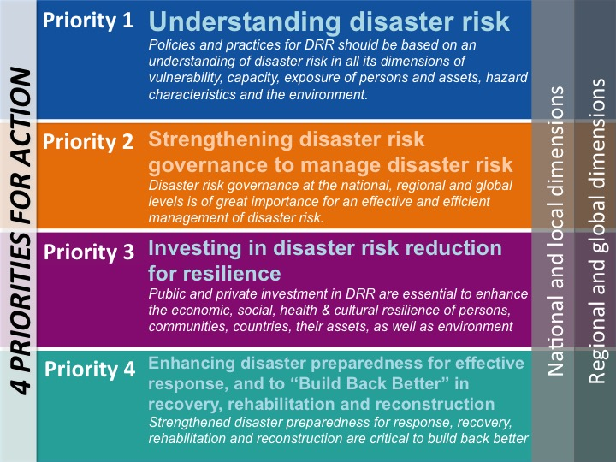
Sendai Framework for DRR 2015-2030
Seven global targets-
  Disaster mortality
  The number of affected people
  Direct disaster economic loss in relation to global gross domestic product GDP).
  Disaster damage to critical infrastructure and disruption of basic services, including health and educational facilities
  The number of countries with national and local disaster risk reduction strategies by 2020.
  International cooperation to developing countries to complement their national actions for implementation of this framework.
  The availability of, and access to, multi-hazard early warning systems and disaster risk information and assessments to the people.
Substantially reduce
Substantially increase
Science and Technology Roadmap to support SFDRR
http://www.preventionweb.net/files/45270_unisdrscienceandtechnologyroadmap.pdf

Slide 3
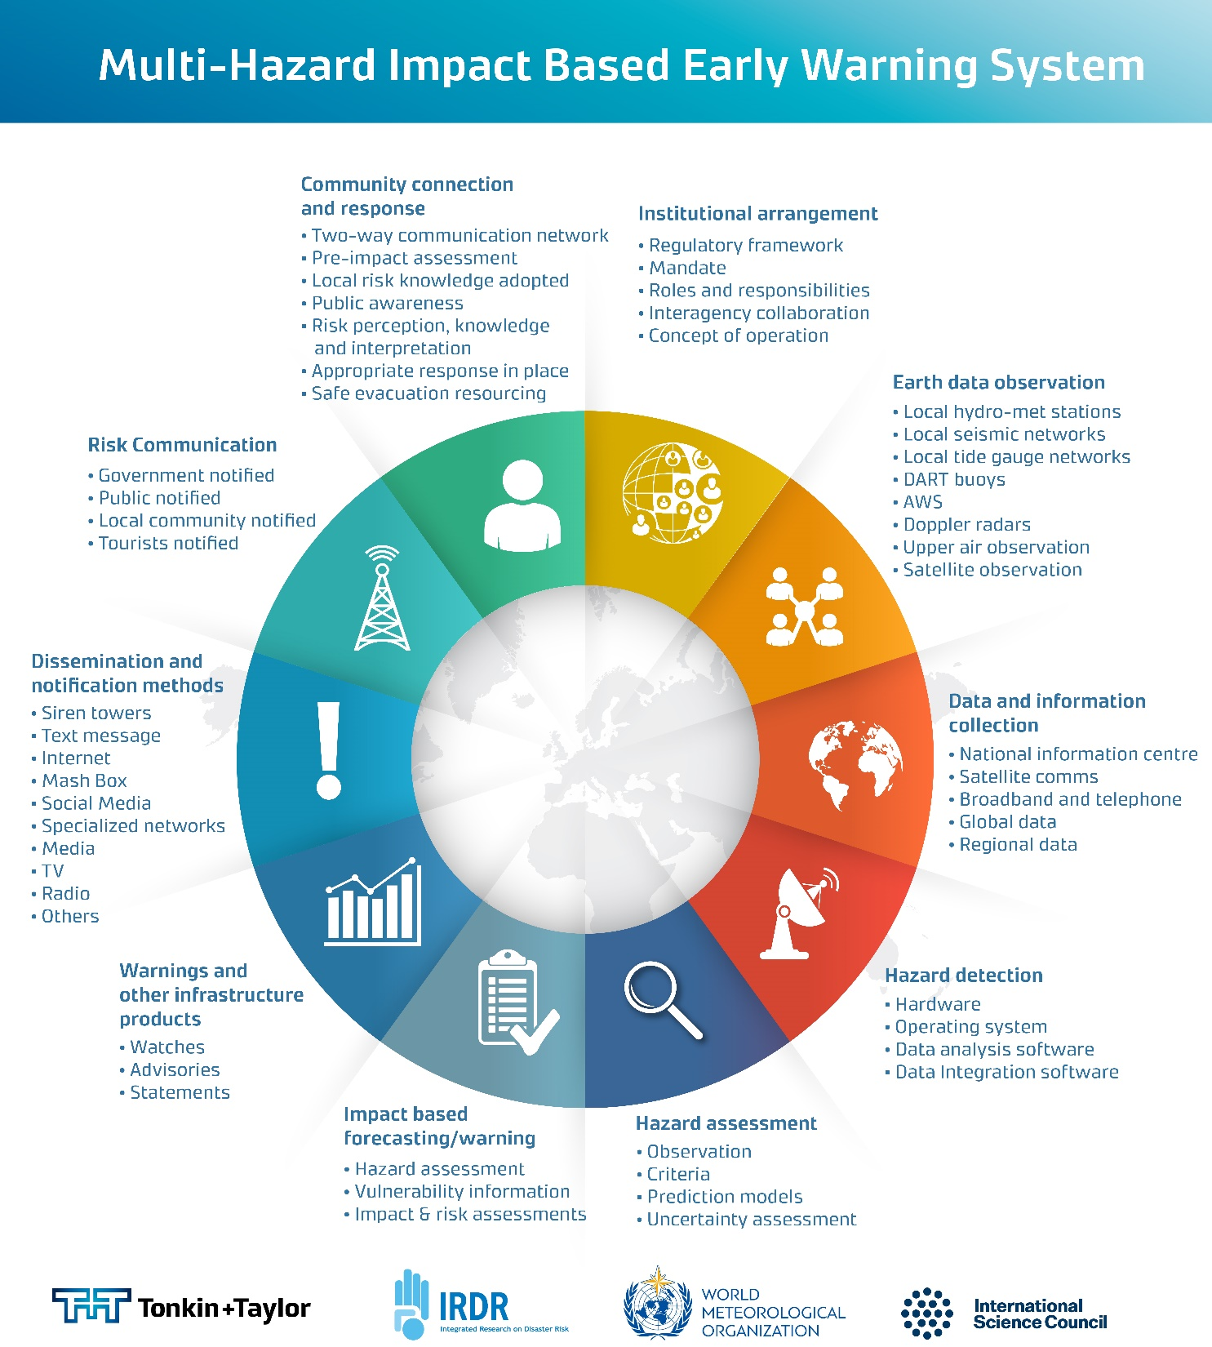

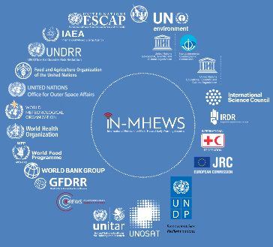
System Based Thinking- Total Warning Concept
(Multi-Hazards Impact Based EWS)

Slide 4
Gaps
Fakhruddin, 2013

Slide 5
System Architecture – Example Tonga (existing)
Hazard Warning Products (Current)
Data Sources
Historical Impact Scenario
Impacts Based Forecasts for Sectors/Clusters
Color Coded Products
Impact Based Forecasts Dissemination
Stakeholders Response & Capacity Building
(Severe) weather forecasts
TMS
Aviation weather forecast
General population at risk
Cyclone
TMS
website
Marine
forecasts (wind & waves)
Coordination and Logistics
TMS ppt for media (TV)
HNWASH
Flood
TMS social media
Urban & coastal flood warning
TMS
Education
NEMO/Joint Center
direct communication
Drought
Meteorological & Hydrological Drought forecast
NRD
TMS marine radio
Food Security and Livelihoods
Economic and Social Recovery
Earthquake analysis
TMS
Earthquake
Tsunami early warning
Communications
Tsunami
Volcanic eruption warning
Volcanic Ash

Slide 6
System Architecture – Example Tonga (Future)
Hazard Warning Products (Proposed)
Data Sources
Historical Impact Scenario
Impacts Based Forecasts for Sectors/Clusters
Color Coded Products
Impact Based Forecasts Dissemination
Stakeholders Response & Capacity Building
(Severe) weather forecasts
TMS
Exposure and vulnerability assessment (spatial and temporal data)
Exposure and Vulnerability assessment for severe weather, aviation and marine
General population at risk
Aviation weather forecast
Cyclone
TMS
website
Marine
forecasts (wind & waves)
Coordination and Logistics
TMS ppt for media (TV)
Exposure and Vulnerability assessment for floods
HNWASH
Flood
TMS social media
Urban & coastal flood warning
TMS
Education
direct communication
NEMO/Joint Center
Exposure and Vulnerability assessment for Drought
Drought
Meteorological & Hydrological Drought forecast
NRD
TMS marine radio
Food Security and Livelihoods
TMS
app
Economic and Social Recovery
Earthquake analysis
TMS
Earthquake
Siren system (NEWS)
Communications
Tsunami early warning
Exposure and Vulnerability assessment for Geo-hazards
Tsunami
TMS live
TV bulletin
Volcanic eruption warning
Volcanic Ash

Slide 7
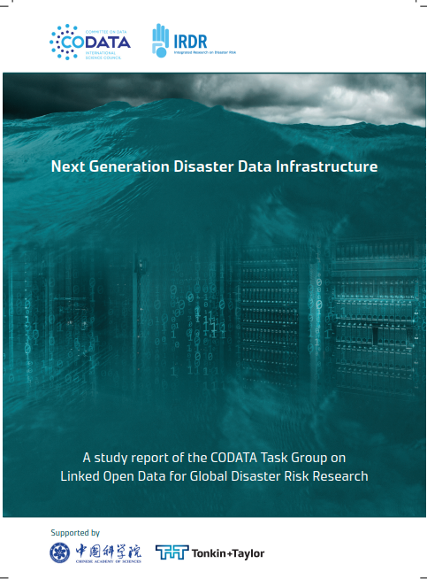
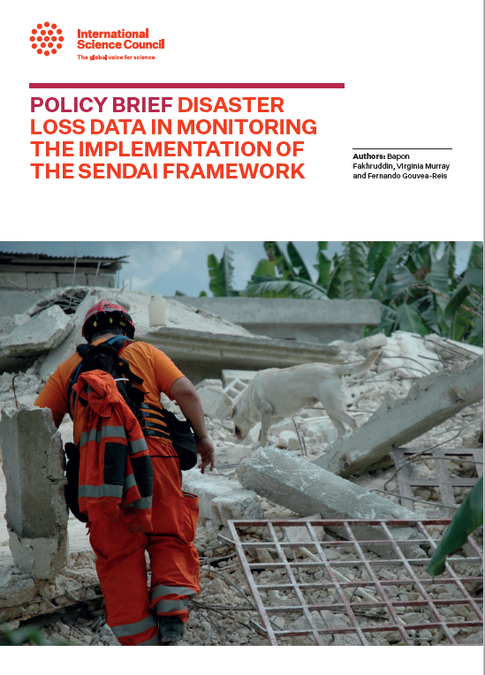
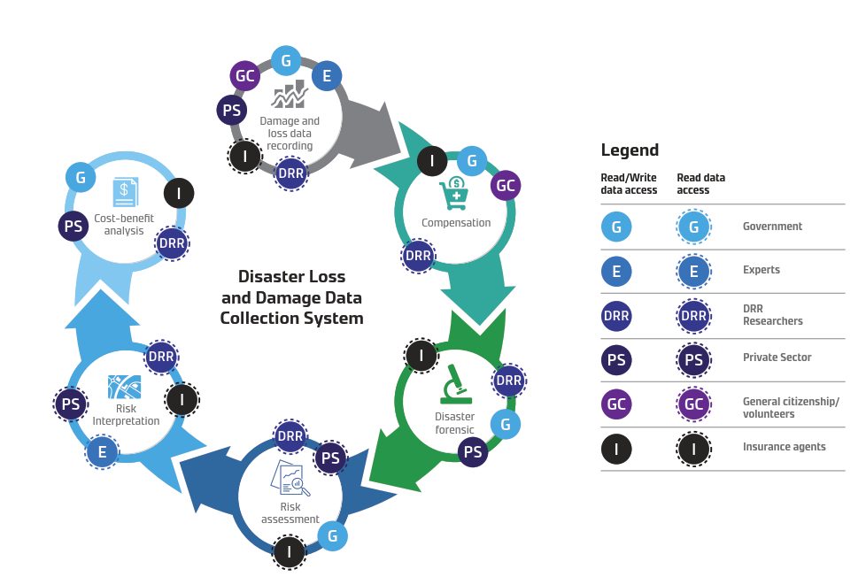
SDG 17: Data, monitoring and accountability

Slide 8
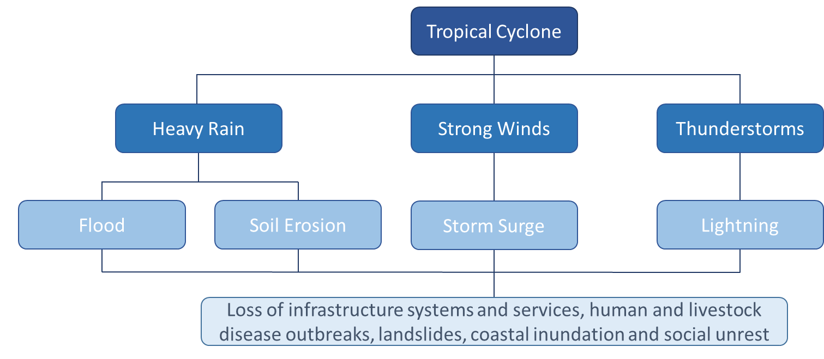
Needs based Information
Warning/forecast information that:
  Localized
  Timely
  Easily understandable language
  Meets end user needs (i.e. thresholds, inundation)

Slide 9
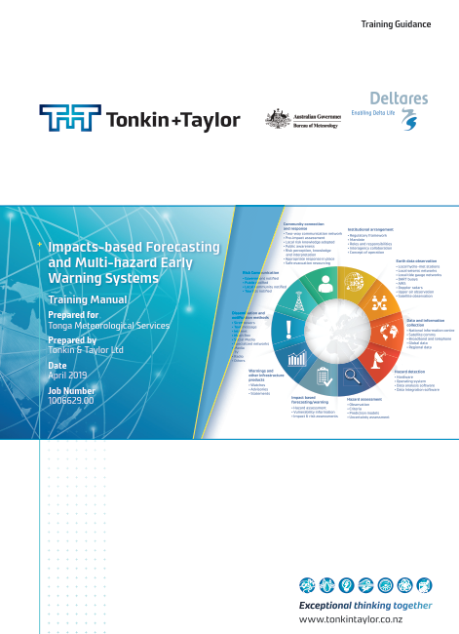
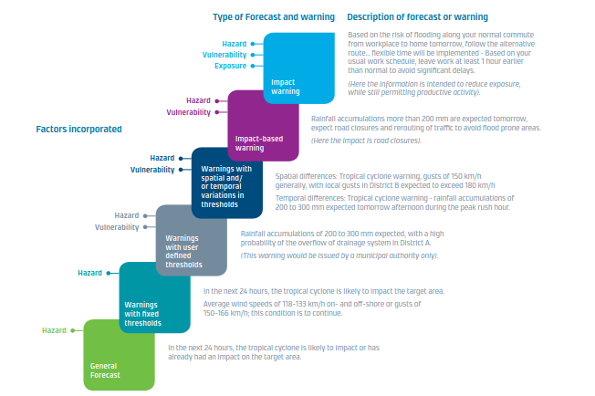
Evolving Impact Based Warning Paradigm

Slide 10
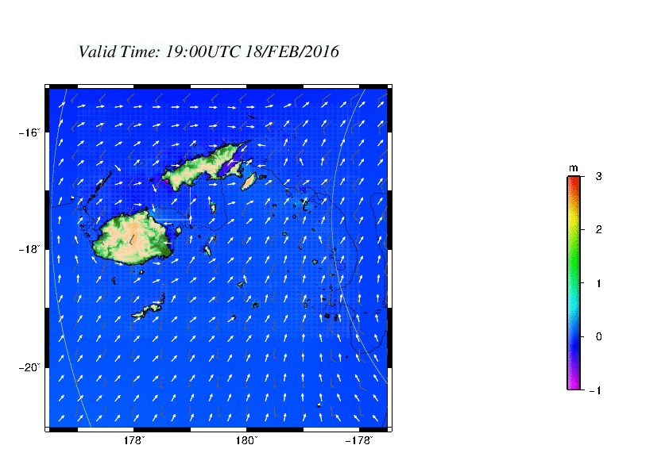
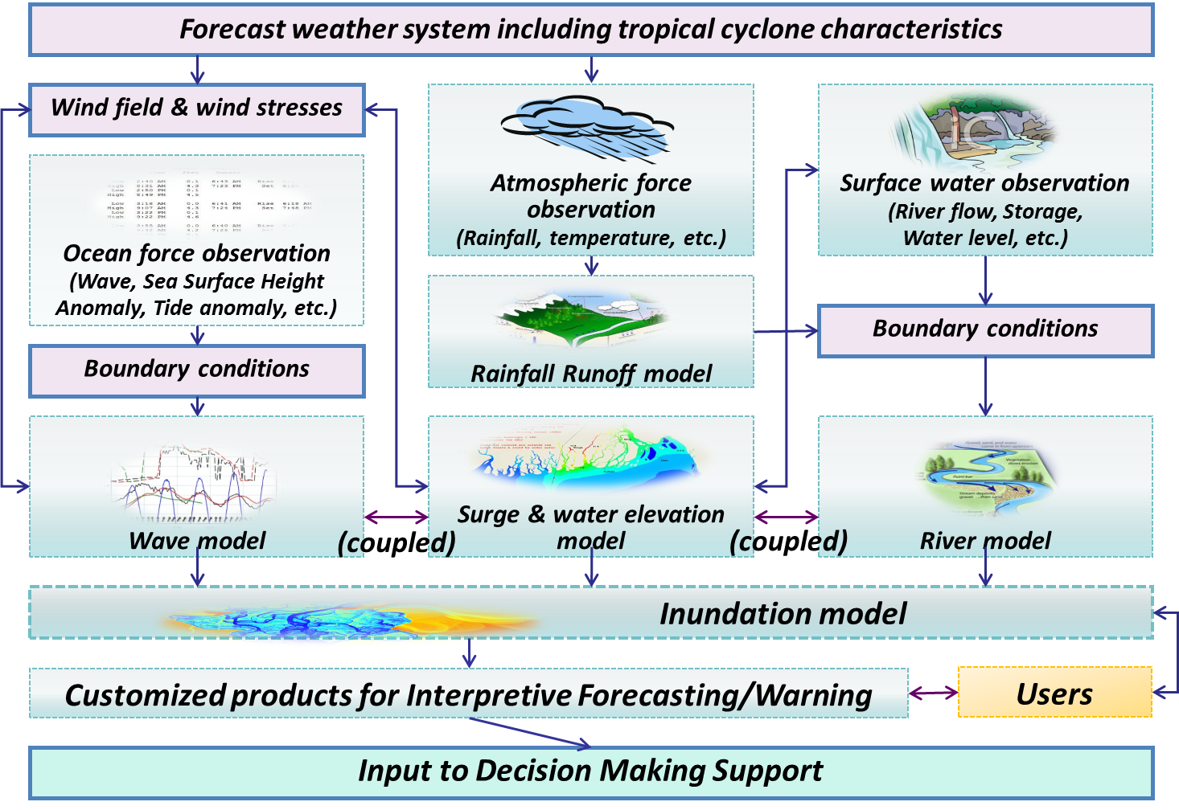
Coastal Inundation Forecasting Demonstration Project (CIFDP)
(Fakhruddin, 2015; 2017)

Slide 11

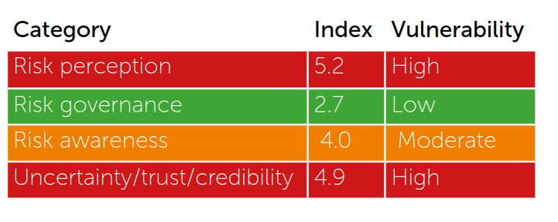
Risk Communications Framework
Risk Perception
The embodiment of uncertainty
Risk Awareness
Interactive exchange of information, opinion and preferences concerning risks.
Risk Assessment
Science and evidence
Risk Interpretation
Risk Management
Policy, preference and values

Slide 12
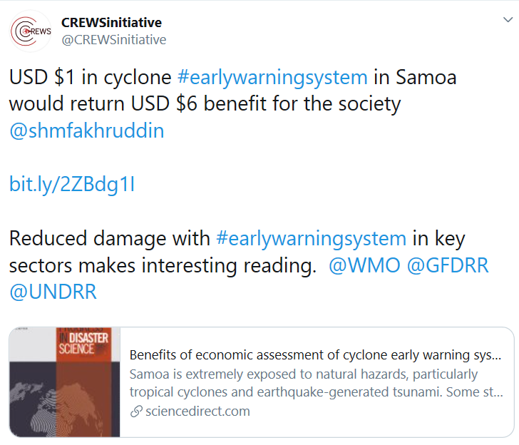
Economic- Benefits
Action to build disaster resilience is poorly incentivised (ODI, 2015)
Economic benefit of the flood early warning system revealed a return of $US559 for each dollar of investment (RIMES, 2013)
Experiment showed that every USD 1 invested, a return of USD 40.85 in benefits over a ten-year period may be realized. Case study from Bangladesh (World Bank, 2012).
USD 1 investment, a return of USD 6 in benefits in the Pacific cyclone early warning system. Case study from Samoa (Fakhruddin, 2019)
Notes:
Investment in DRM is very low in most countries and represents a tiny proportion of international
development assistance. The majority of DRM related development financing remains for emergency response.
This is because decision makers tend not to prioritise investments to build resilience, as these do not produce immediate gains or benefits.

Slide 13
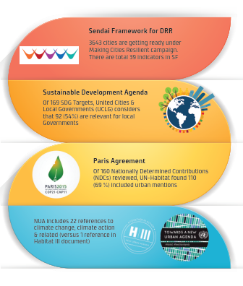
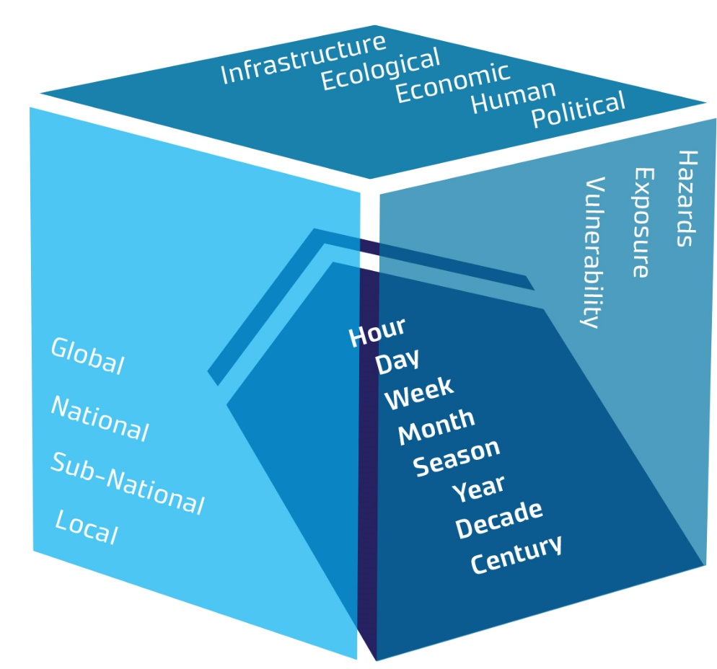
Coherence from Global Frameworks
EWS is a key component for successful implementation of these framework.

Slide 14
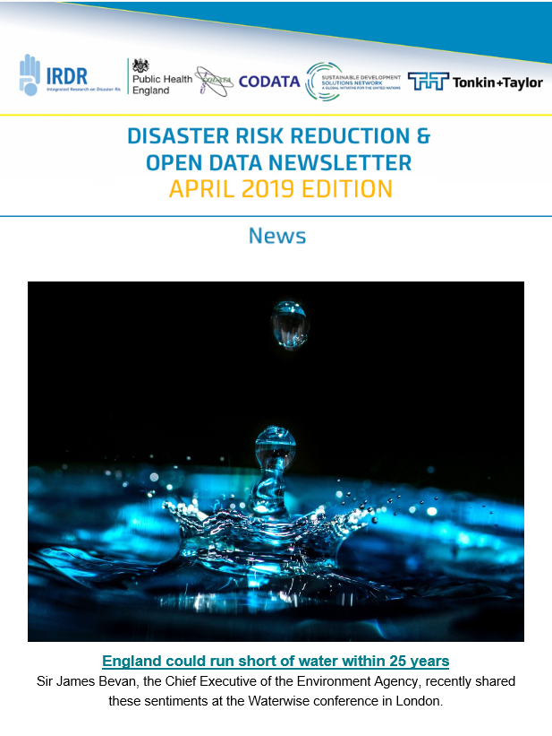

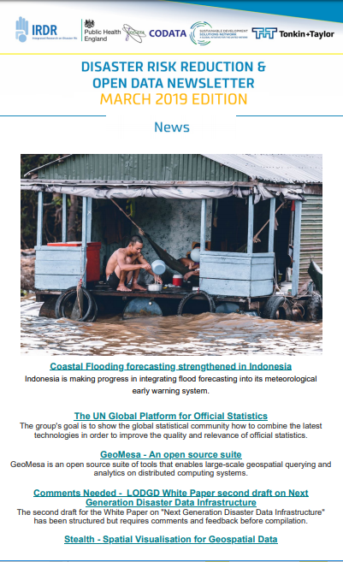
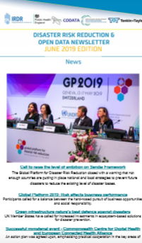

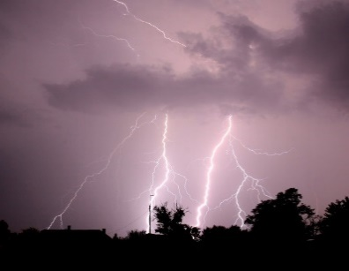
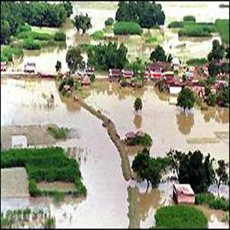
IRDR Data Newsletters

Slide 15
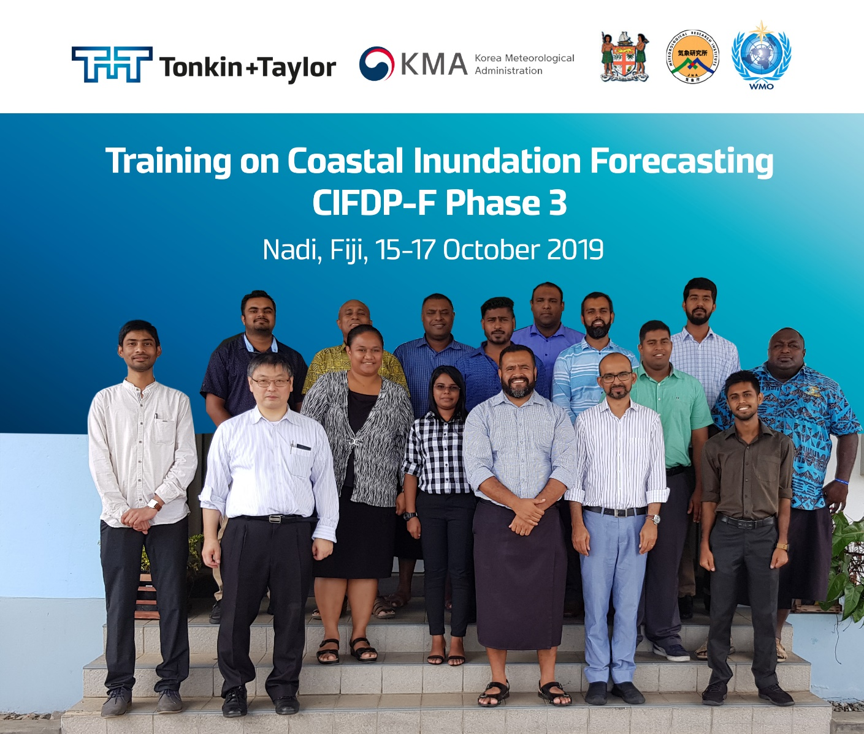
Questions?

